Slide 1
St. Louis Central Corridor West Building Permits
Monthly Report: April 2021

Slide 2
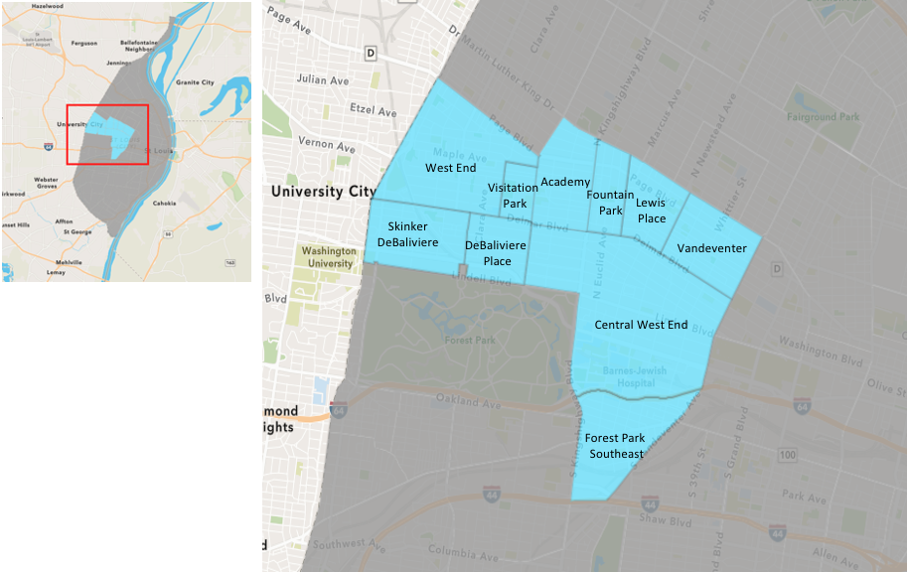
St. Louis Neighborhood Spatial Reference

Slide 3
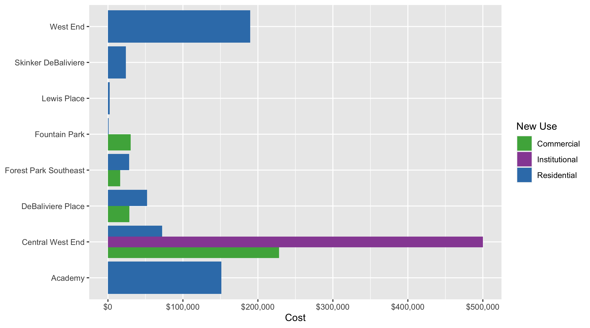
Neighborhood Summary: Average Building Permit Cost

Slide 4
Neighborhood Summary
April 2021 | April 2021 | April 2021 | April 2021
Neighborhood | Average Cost | # of Permits | Total Value of Permits
Academy | $151,125 | 3 | $453,375
Central West End | $141,072 | 47 | $6,630,380
DeBaliviere Place | $44,315 | 6 | $265,891
Forest Park Southeast | $24,964 | 11 | $274,600
Fountain Park | $15,667 | 4 | $62,669
Lewis Place | $2,333 | 3 | $7,000
Skinker DeBaliviere | $23,924 | 6 | $143,543
Vandeventer | $0 | 0 | $0
Visitation Park | $0 | 0 | $0
West End | $189,803 | 5 | $949,014
Last 6 Months | Last 6 Months | Last 6 Months | Last 6 Months
Neighborhood | Average Cost | # of Permits | Total Value of Permits
Academy | $58,270 | 16 | $932,325
Central West End | $679,518 | 200 | $135,903,580
DeBaliviere Place | $313,595 | 31 | $9,721,443
Forest Park Southeast | $722,407 | 69 | $49,846,057
Fountain Park | $293,752 | 10 | $2,937,517
Lewis Place | $9,806 | 10 | $98,063
Skinker DeBaliviere | $40,752 | 41 | $1,670,815
Vandeventer | $25,554 | 6 | $153,323
Visitation Park | $7,774 | 1 | $7,774
West End | $343,854 | 44 | $15,129,592

Slide 5
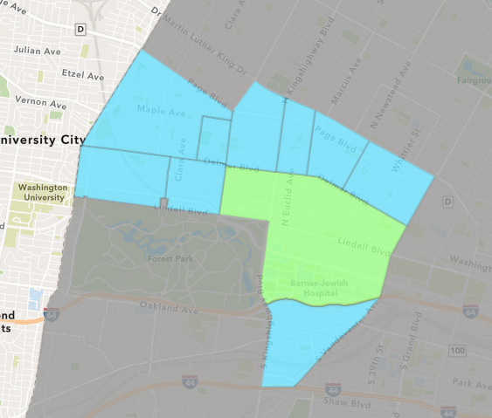
Central West End
April 2021 Neighborhood Cost Breakdown
Mean: $141,072
Median: $35,000
Range: $2,200 - $2,180,254

Slide 6
Central West End: Summary Notes
47 building permits in April 2021
176.47% change compared to April 2020 (17 total building permits)
$141,072: Average building permit cost in April 2021
10.49% change compared to April 2020 ($127,677)
150 total building permits in 2021
18.11% change YTD compared to this time in 2020 (127 total building permits)
$617,547: YTD average building permit cost in 2021
50.01% change YTD compared to this time in 2020 ($411,670)

Slide 7
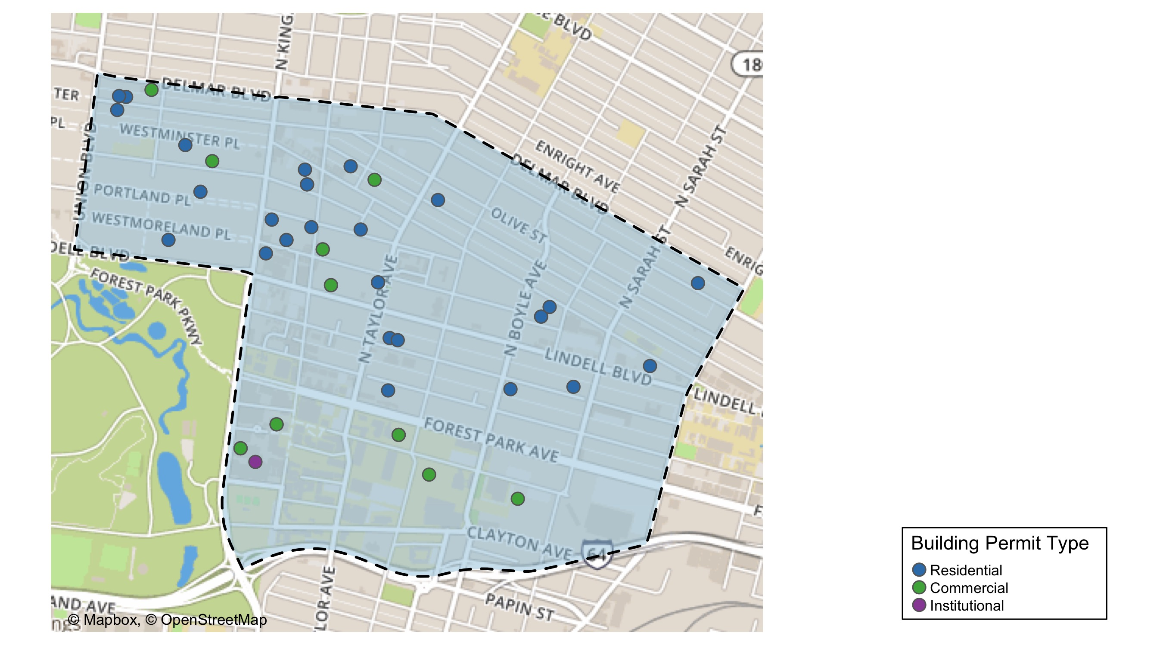
Central West End

Slide 8
Neighborhood Summary
April 2021 | April 2021 | April 2021 | April 2021
Permit Use | Average Cost | # of Permits | Total Value of Permits
Commercial | $228,178 | 18 | $4,107,197
Industrial | $0 | 0 | $0
Institutional | $500,000 | 1 | $500,000
Residential | $72,257 | 28 | $2,023,183
Last 6 Months | Last 6 Months | Last 6 Months | Last 6 Months
Permit Use | Average Cost | # of Permits | Total Value of Permits
Commercial | $1,239,011 | 75 | $92,925,836
Industrial | $0 | 0 | $0
Institutional | $91,363 | 14 | $1,279,086
Residential | $375,664 | 111 | $41,698,658

Slide 9
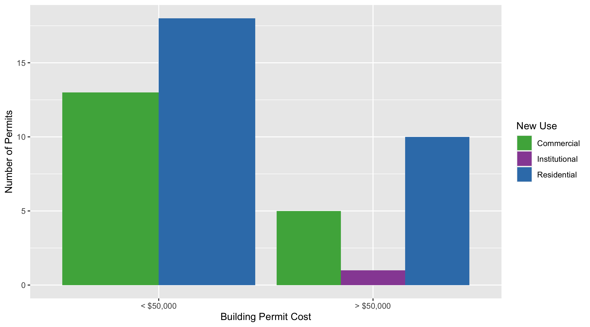
Central West End Permit Cost Breakdown

Slide 10
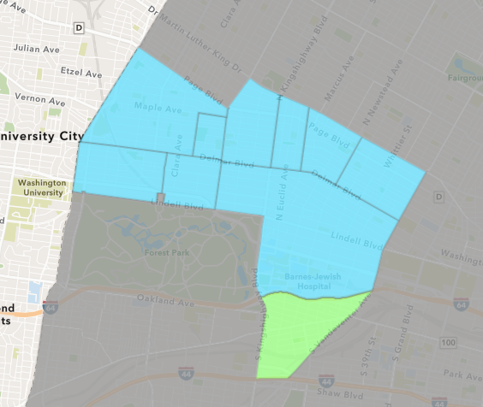
Forest Park Southeast
April 2021 Neighborhood Cost Breakdown
Mean: $24,964
Median: $3,700
Range: $100 - $90,000

Slide 11
Forest Park Southeast: Summary Notes
11 building permits in April 2021
266.67% change compared to April 2020 (3 total building permits)
$24,964: Average building permit cost in April 2021
-85.43% change compared to April 2020 ($171,381)
54 total building permits in 2021
50.00% change YTD compared to this time in 2020 (36 total building permits)
$833,274: YTD average building permit cost in 2021
355.52% change YTD compared to this time in 2020 ($182,930)

Slide 12
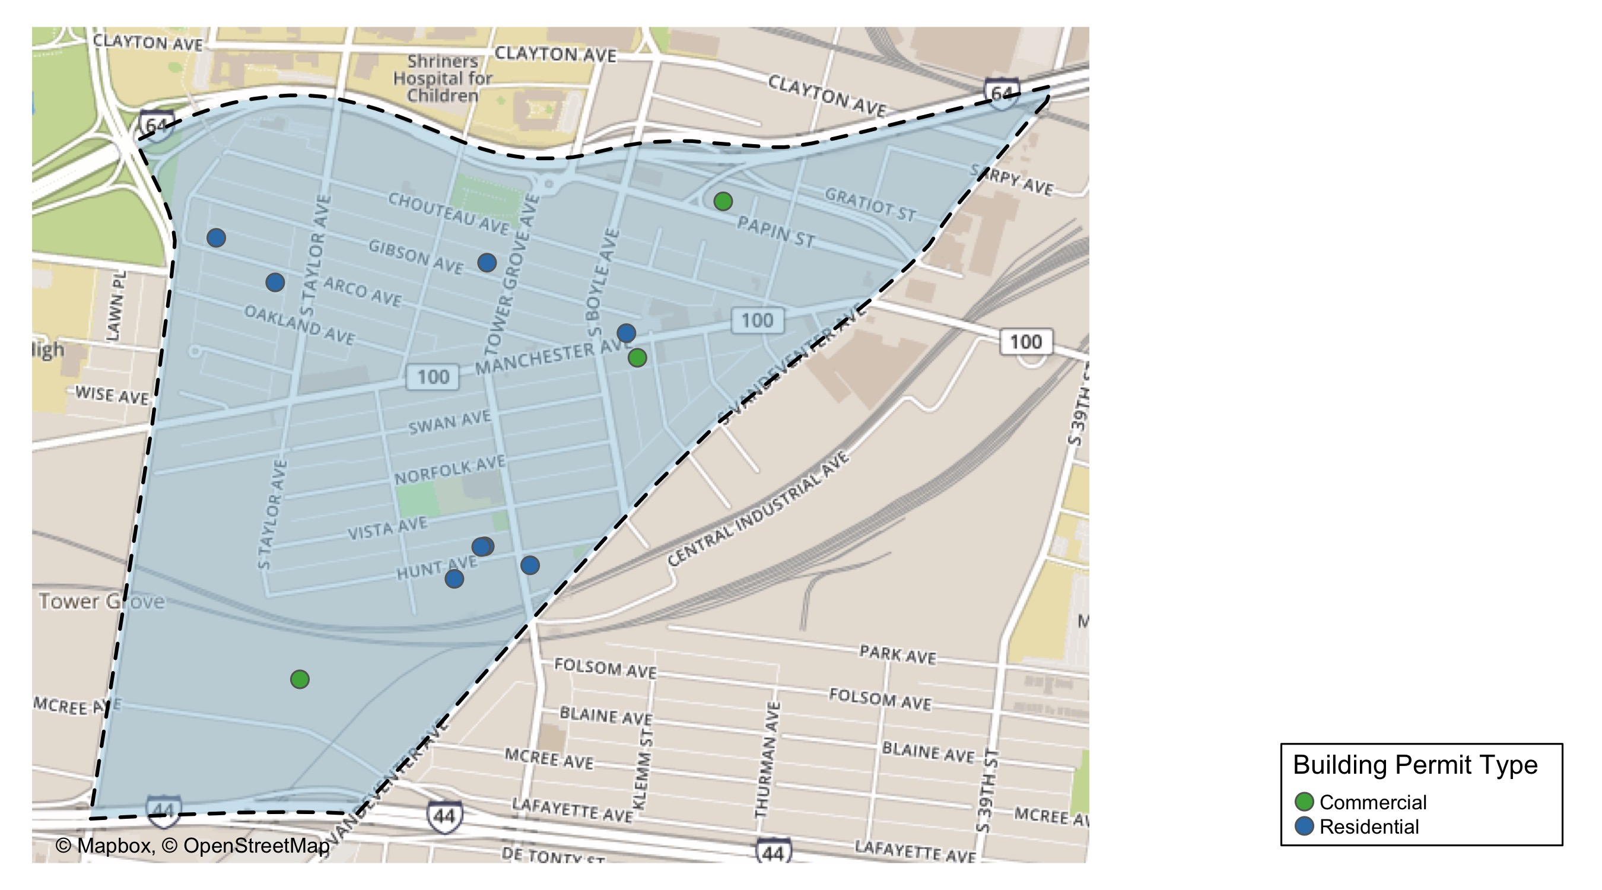
Forest Park Southeast

Slide 13
Neighborhood Summary
April 2021 | April 2021 | April 2021 | April 2021
Permit Use | Average Cost | # of Permits | Total Value of Permits
Commercial | $16,300 | 3 | $48,900
Industrial | $0 | 0 | $0
Institutional | $0 | 0 | $0
Residential | $28,212 | 8 | $225,700
Last 6 Months | Last 6 Months | Last 6 Months | Last 6 Months
Permit Use | Average Cost | # of Permits | Total Value of Permits
Commercial | $264,387 | 23 | $6,080,903
Industrial | $0 | 0 | $0
Institutional | $0 | 0 | $0
Residential | $951,416 | 46 | $43,765,154

Slide 14
Forest Park Southeast Individual Permit Breakdown
Owner | New Use | Cost | address
GROVE EQUITIES LLC | Commercial | $3,700 | 4178 MANCHESTER AV
DAZ PROPERTIES LLC | Residential | $7,000 | 4567 ARCO AV
BOWDEN, CHRISTIAN L | Residential | $34,000 | 4375 GIBSON AV
4191 MANCHESTER REALTY LLC | Residential | $3,400 | 4187 MANCHESTER AV
GRBIC, ERMIN & LEJLA | Residential | $100 | 4520 ARCO AV
PENTLAND, JOSEPH | Residential | $500 | 1500 TOWER GROVE AV
WASHINGTON UNIVERSITY MEDICAL CENTER | Commercial | $45,000 | 4145 PAPIN ST
HSE INVESTMENTS LLC | Residential | $90,000 | 4323 HUNT AV
JEMZ INVESTMENTS & PROPERTIES LLC | Residential | $90,000 | 4319 HUNT AV
GREEN STREET MCREE INVESTORS LLC | Commercial | $200 | 4591 MCREE AV
WOOD, DANIEL W | Residential | $700 | 4342 HUNT AV

Slide 15
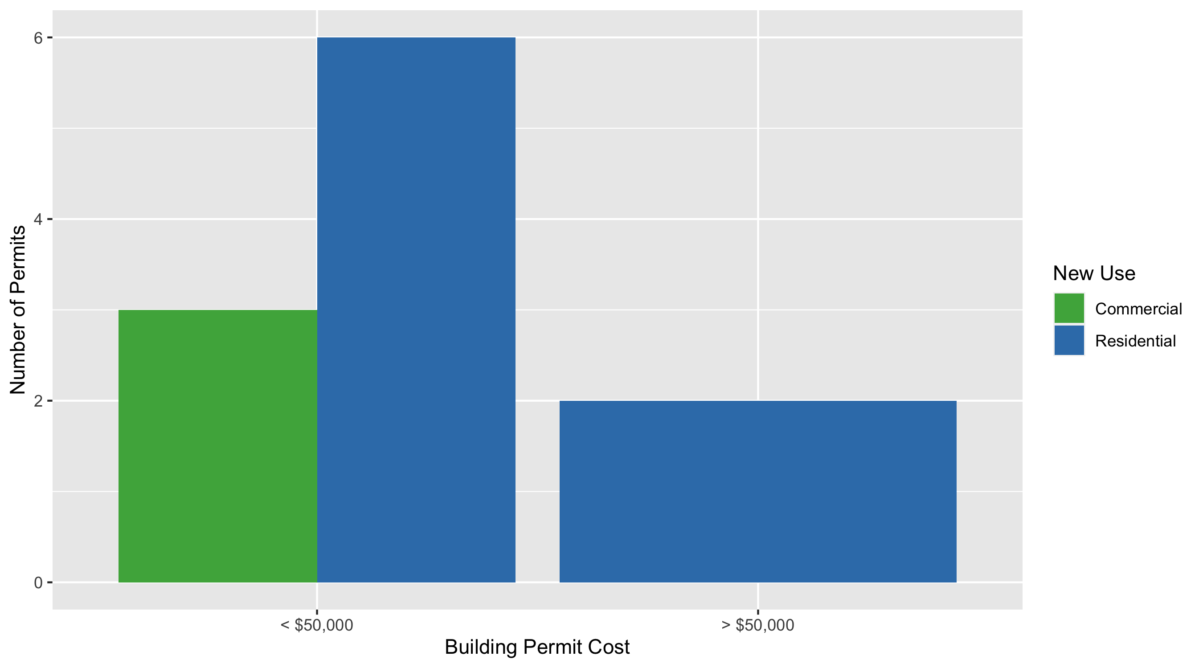
Forest Park Southeast Permit Cost Breakdown

Slide 16
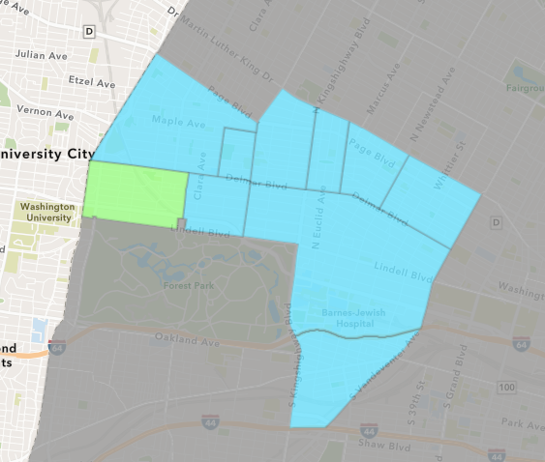
Skinker DeBaliviere
April 2021 Neighborhood Cost Breakdown
Mean: $23,924
Median: $17,676
Range: $2,950 - $75,000

Slide 17
Skinker DeBaliviere: Summary Notes
6 building permits in April 2021
20.00% change compared to April 2020 (5 total building permits)
$23,924: Average building permit cost in April 2021
4.13% change compared to April 2020 ($22,976)
28 total building permits in 2021
-34.88% change YTD compared to this time in 2020 (43 total building permits)
$37,704: YTD average building permit cost in 2021
83.92% change YTD compared to this time in 2020 ($20,501)

Slide 18
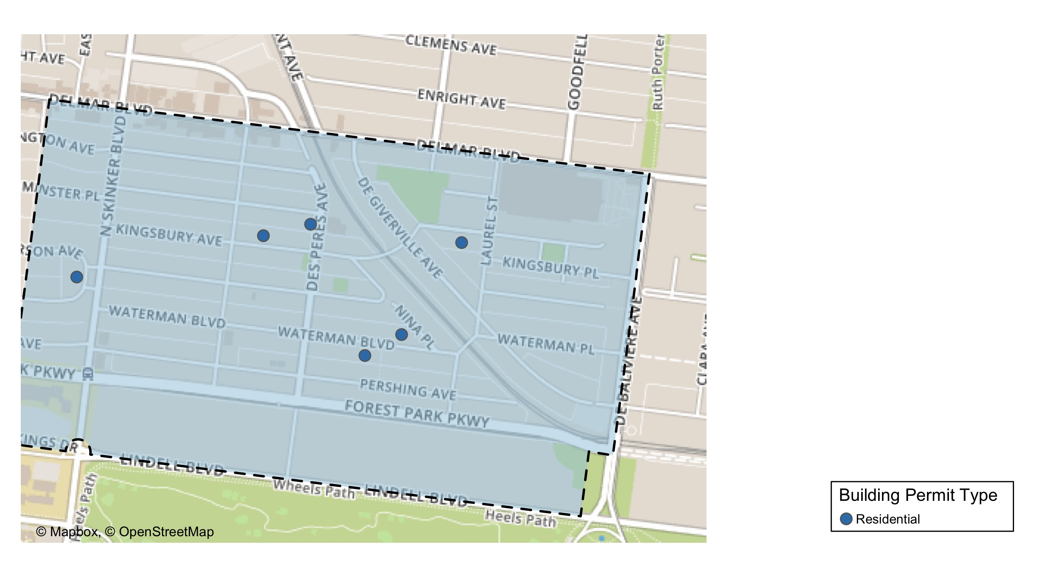
Skinker DeBaliviere

Slide 19
Neighborhood Summary
April 2021 | April 2021 | April 2021 | April 2021
Permit Use | Average Cost | # of Permits | Total Value of Permits
Commercial | $0 | 0 | $0
Industrial | $0 | 0 | $0
Institutional | $0 | 0 | $0
Residential | $23,924 | 6 | $143,543
Last 6 Months | Last 6 Months | Last 6 Months | Last 6 Months
Permit Use | Average Cost | # of Permits | Total Value of Permits
Commercial | $111,562 | 4 | $446,248
Industrial | $0 | 0 | $0
Institutional | $0 | 0 | $0
Residential | $33,096 | 37 | $1,224,567

Slide 20
Skinker DeBaliviere Individual Permit Breakdown
Owner | New Use | Cost | address
MAR, DAVID | Residential | $13,352 | 5914 WATERMAN BLVD
BONDS, RONALD | Residential | $75,000 | 5818 WESTMINSTER PL
RACHEL HARSLEY | Residential | $2,950 | 6006 WESTMINSTER PL
NACY, JAMES O II | Residential | $22,000 | 5847 WATERMAN BLVD
BENDER, ELIZABETH A & | Residential | $6,841 | 6045 KINGSBURY AV
BARTON, JONATHAN T & JENNIFER L | Residential | $23,400 | 6200 MCPHERSON AV

Slide 21
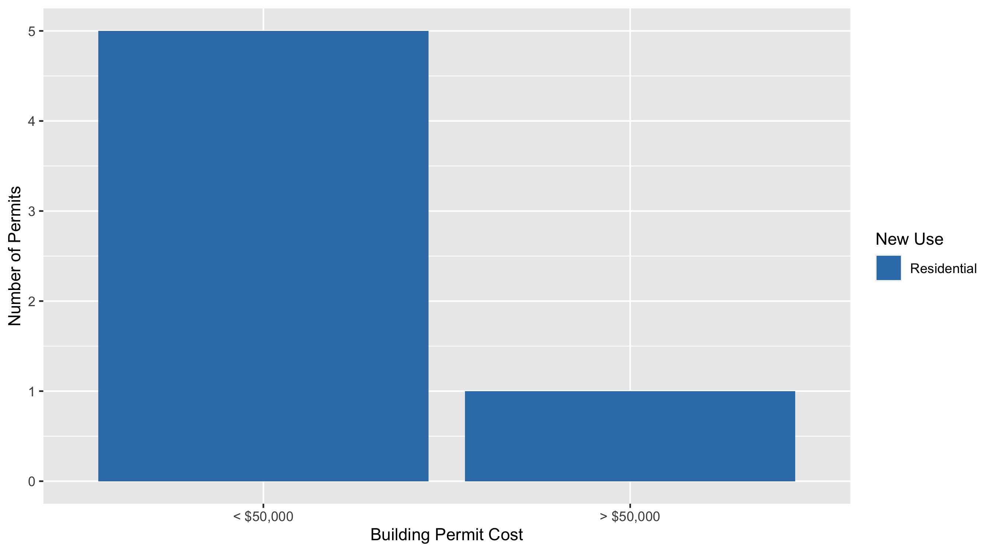
Skinker DeBaliviere Permit Cost Breakdown

Slide 22
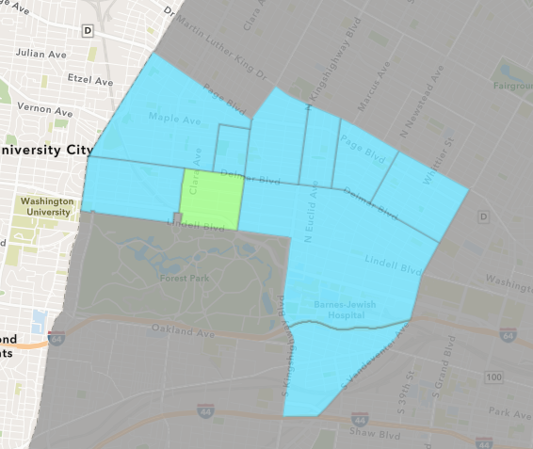
DeBaliviere Place
April 2021 Neighborhood Cost Breakdown
Mean: $44,315
Median: $29,820
Range: $3,396 - $135,000

Slide 23
DeBaliviere Place: Summary Notes
6 building permits in April 2021
500.00% change compared to April 2020 (1 total building permits)
$44,315: Average building permit cost in April 2021
-89.63% change compared to April 2020 ($427,454)
22 total building permits in 2021
175.00% change YTD compared to this time in 2020 (8 total building permits)
$70,195: YTD average building permit cost in 2021
-16.57% change YTD compared to this time in 2020 ($84,132)

Slide 24
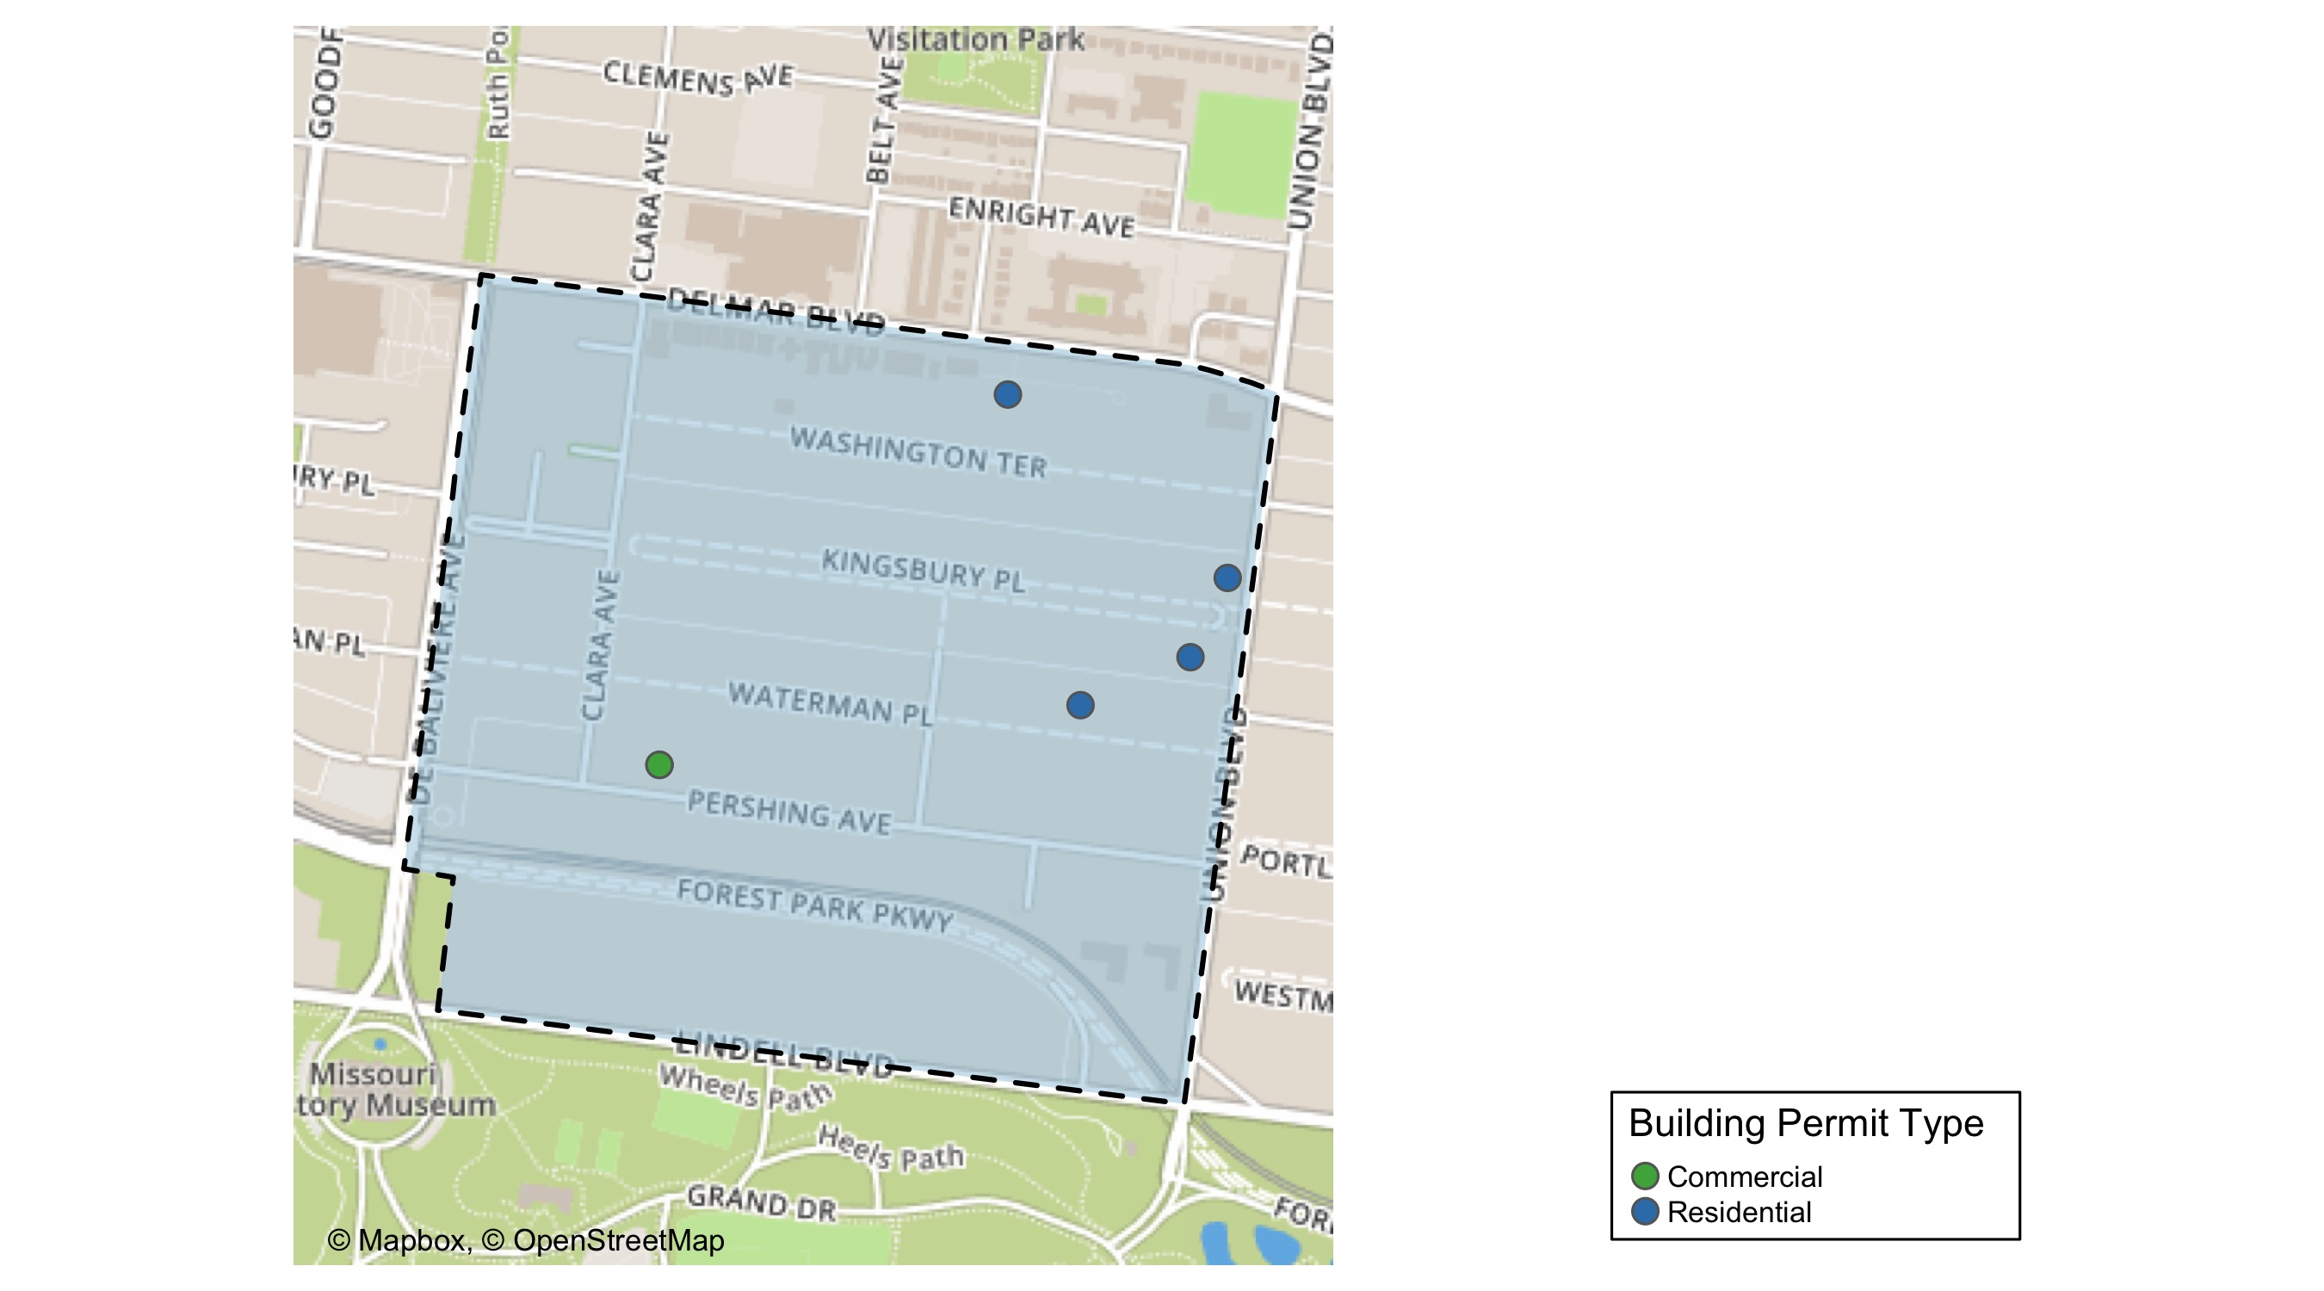
DeBaliviere Place

Slide 25
Neighborhood Summary
April 2021 | April 2021 | April 2021 | April 2021
Permit Use | Average Cost | # of Permits | Total Value of Permits
Commercial | $28,698 | 2 | $57,396
Industrial | $0 | 0 | $0
Institutional | $0 | 0 | $0
Residential | $52,124 | 4 | $208,495
Last 6 Months | Last 6 Months | Last 6 Months | Last 6 Months
Permit Use | Average Cost | # of Permits | Total Value of Permits
Commercial | $24,132 | 3 | $72,396
Industrial | $0 | 0 | $0
Institutional | $0 | 0 | $0
Residential | $344,609 | 28 | $9,649,047

Slide 26
DeBaliviere Place Individual Permit Breakdown
Owner | New Use | Cost | address
JEK SEP IRA FUND LLC | Residential | $135,000 | 5420 DELMAR PLACE CT
BUFORD, JAMES H & SUSAN E | Residential | $13,854 | 1 KINGSBURY PL
SEWARD, JERMAL L II & RAHCEL L | Residential | $16,000 | 4 KINGSBURY PL
SERVICE EMPLOYEES INTERNATIONAL UNIO | Commercial | $54,000 | 5585 PERSHING AV
SERVICE EMPLOYEES INTERNATIONAL UNIO | Commercial | $3,396 | 5585 PERSHING AV
NASH, ALISON C & CLARENCE E DULA | Residential | $43,641 | 57 WATERMAN PL

Slide 27
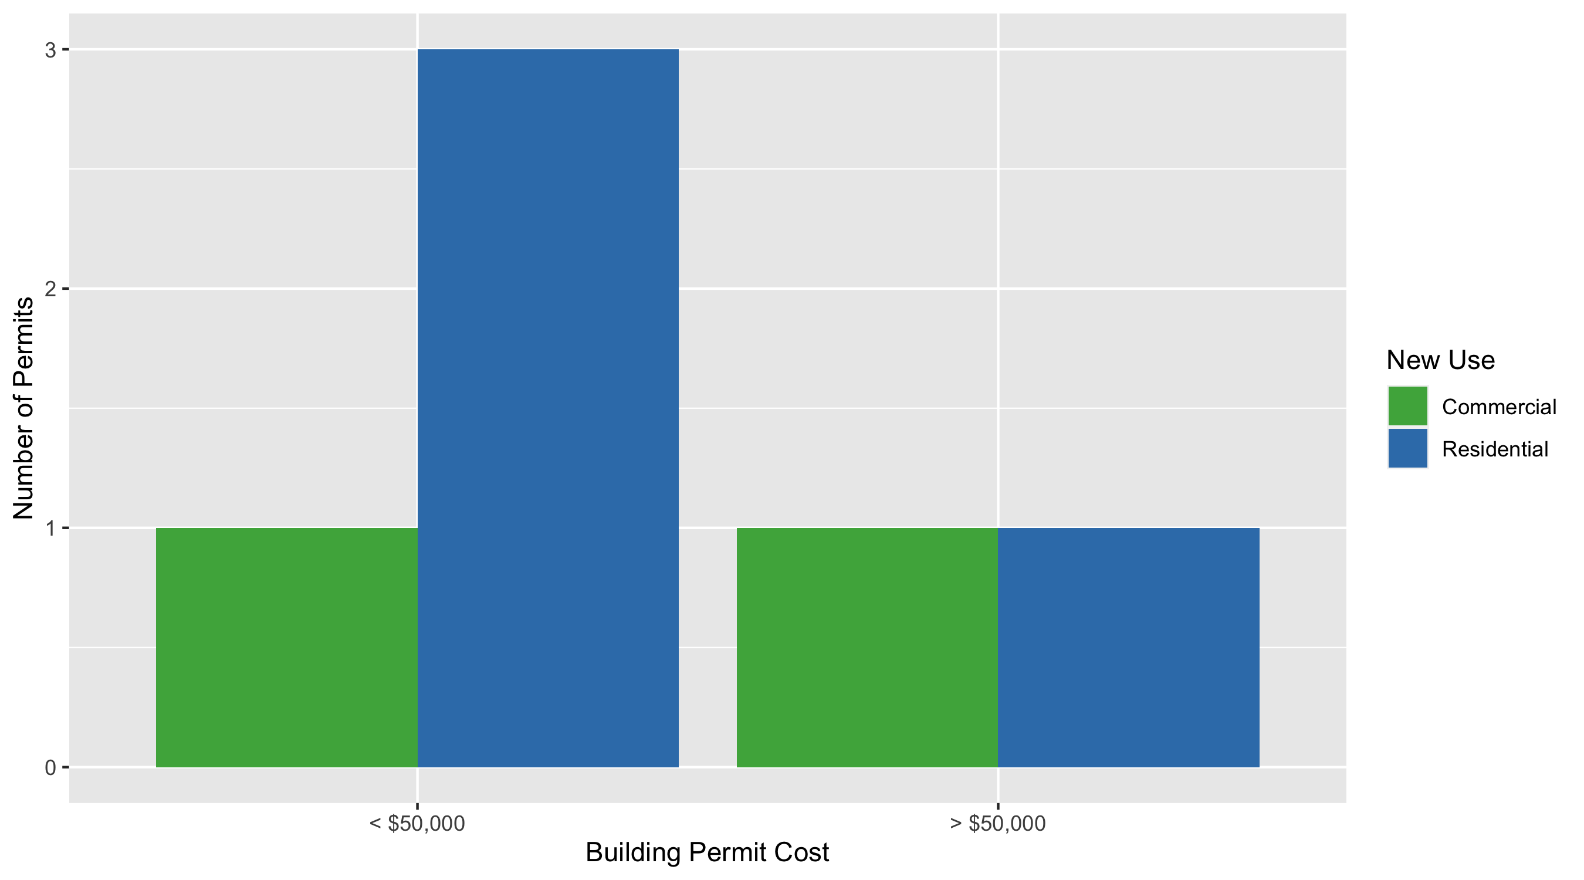
DeBaliviere Place Permit Cost Breakdown

Slide 28
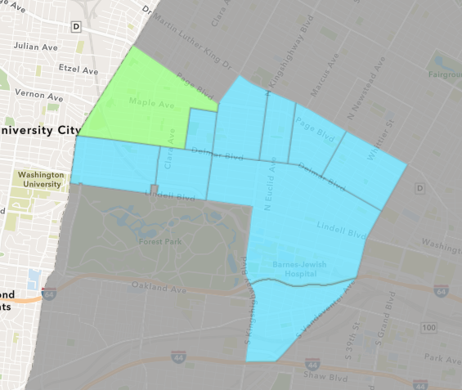
West End
April 2021 Neighborhood Cost Breakdown
Mean: $189,803
Median: $75,000
Range: $55,000 - $659,014

Slide 29
West End: Summary Notes
5 building permits in April 2021
66.67% change compared to April 2020 (3 total building permits)
$189,803: Average building permit cost in April 2021
17.56% change compared to April 2020 ($161,450)
29 total building permits in 2021
-14.71% change YTD compared to this time in 2020 (34 total building permits)
$121,910: YTD average building permit cost in 2021
-31.72% change YTD compared to this time in 2020 ($178,539)

Slide 30
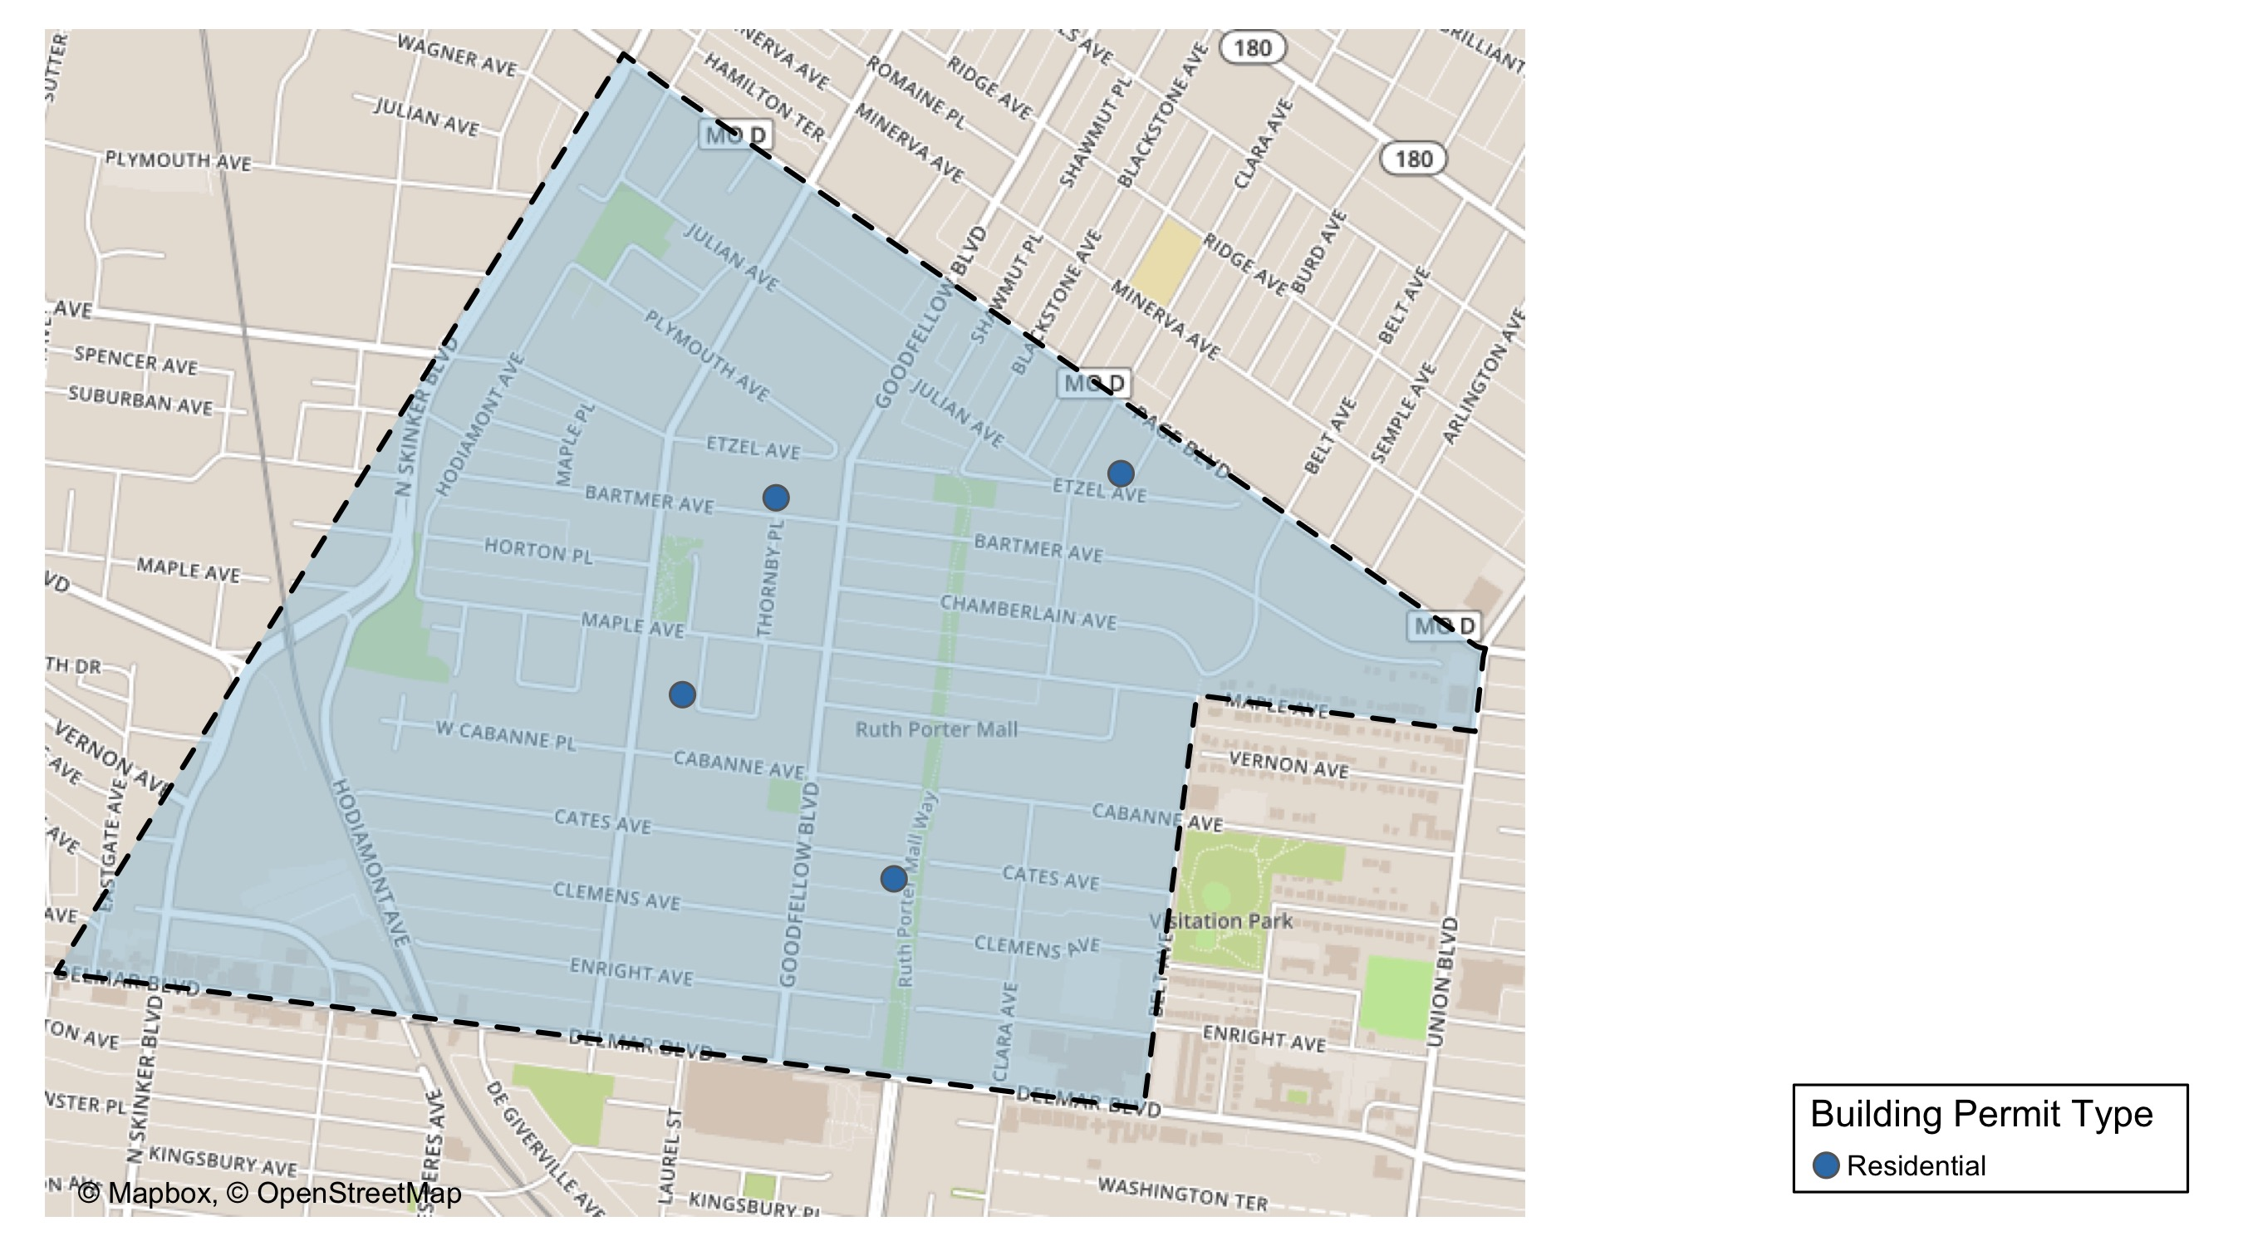
West End

Slide 31
Neighborhood Summary
April 2021 | April 2021 | April 2021 | April 2021
Permit Use | Average Cost | # of Permits | Total Value of Permits
Commercial | $0 | 0 | $0
Industrial | $0 | 0 | $0
Institutional | $0 | 0 | $0
Residential | $189,803 | 5 | $949,014
Last 6 Months | Last 6 Months | Last 6 Months | Last 6 Months
Permit Use | Average Cost | # of Permits | Total Value of Permits
Commercial | $134,254 | 10 | $1,342,536
Industrial | $0 | 0 | $0
Institutional | $0 | 0 | $0
Residential | $405,502 | 34 | $13,787,056

Slide 32
West End Individual Permit Breakdown
Owner | New Use | Cost | address
URBAN CORE CONSTRUCTION LLC | Residential | $100,000 | 5835 BARTMER AV
IN & OUT MANAGEMENT SERVICE LLC | Residential | $75,000 | 935 MARYVILLE AV
RISING HUNT INC | Residential | $55,000 | 5676-78 CATES AV
DELMAR DIVINE MASTER LANDLORD COMM. | Residential | $659,014 | 5535 DELMAR BLVD
LOS LLC | Residential | $60,000 | 1207 MONTCLAIR AV

Slide 33
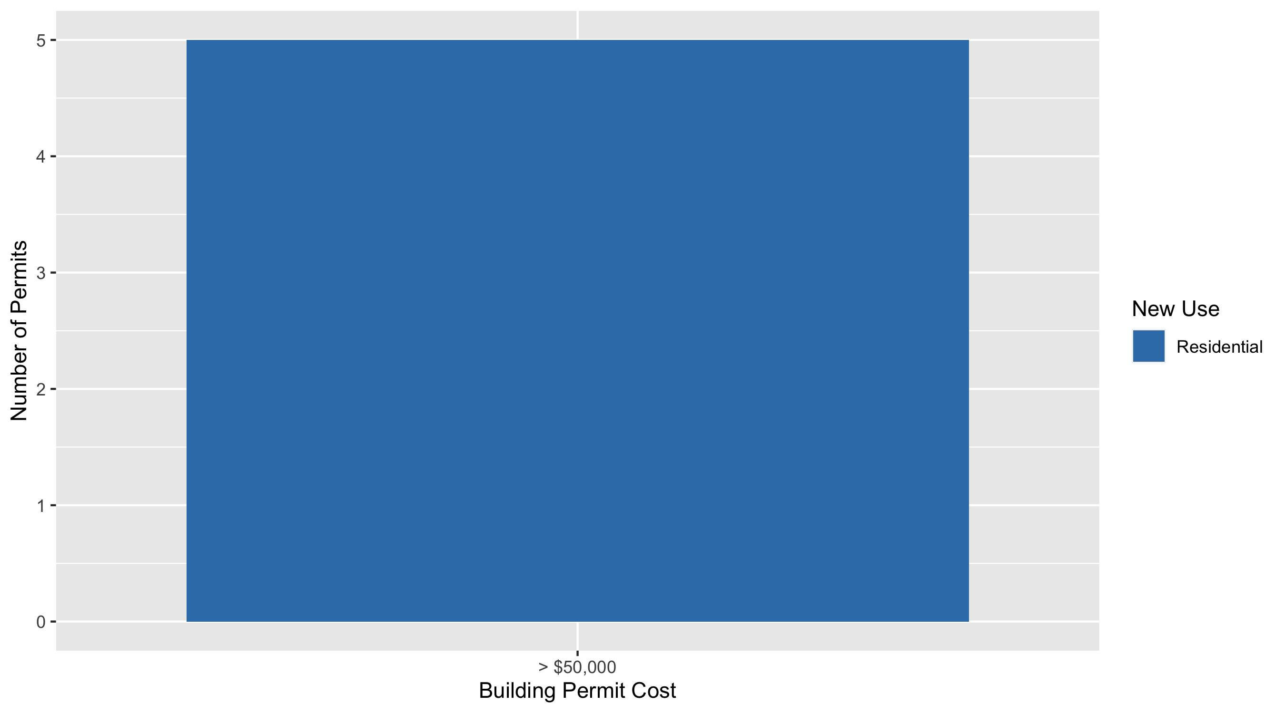
West End Permit Cost Breakdown

Slide 34
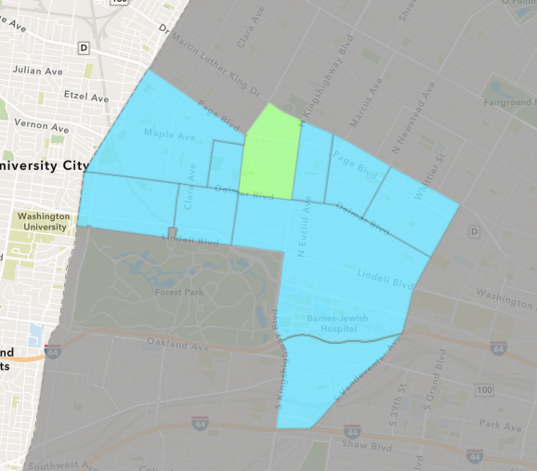
Academy
April 2021 Neighborhood Cost Breakdown
Mean: $151,125
Median: $2,000
Range: $1,375 - $450,000

Slide 35
Academy: Summary Notes
3 building permits in April 2021
200.00% change compared to April 2020 (1 total building permits)
$151,125: Average building permit cost in April 2021
504.50% change compared to April 2020 ($25,000)
8 total building permits in 2021
-27.27% change YTD compared to this time in 2020 (11 total building permits)
$84,069: YTD average building permit cost in 2021
2.76% change YTD compared to this time in 2020 ($81,814)

Slide 36
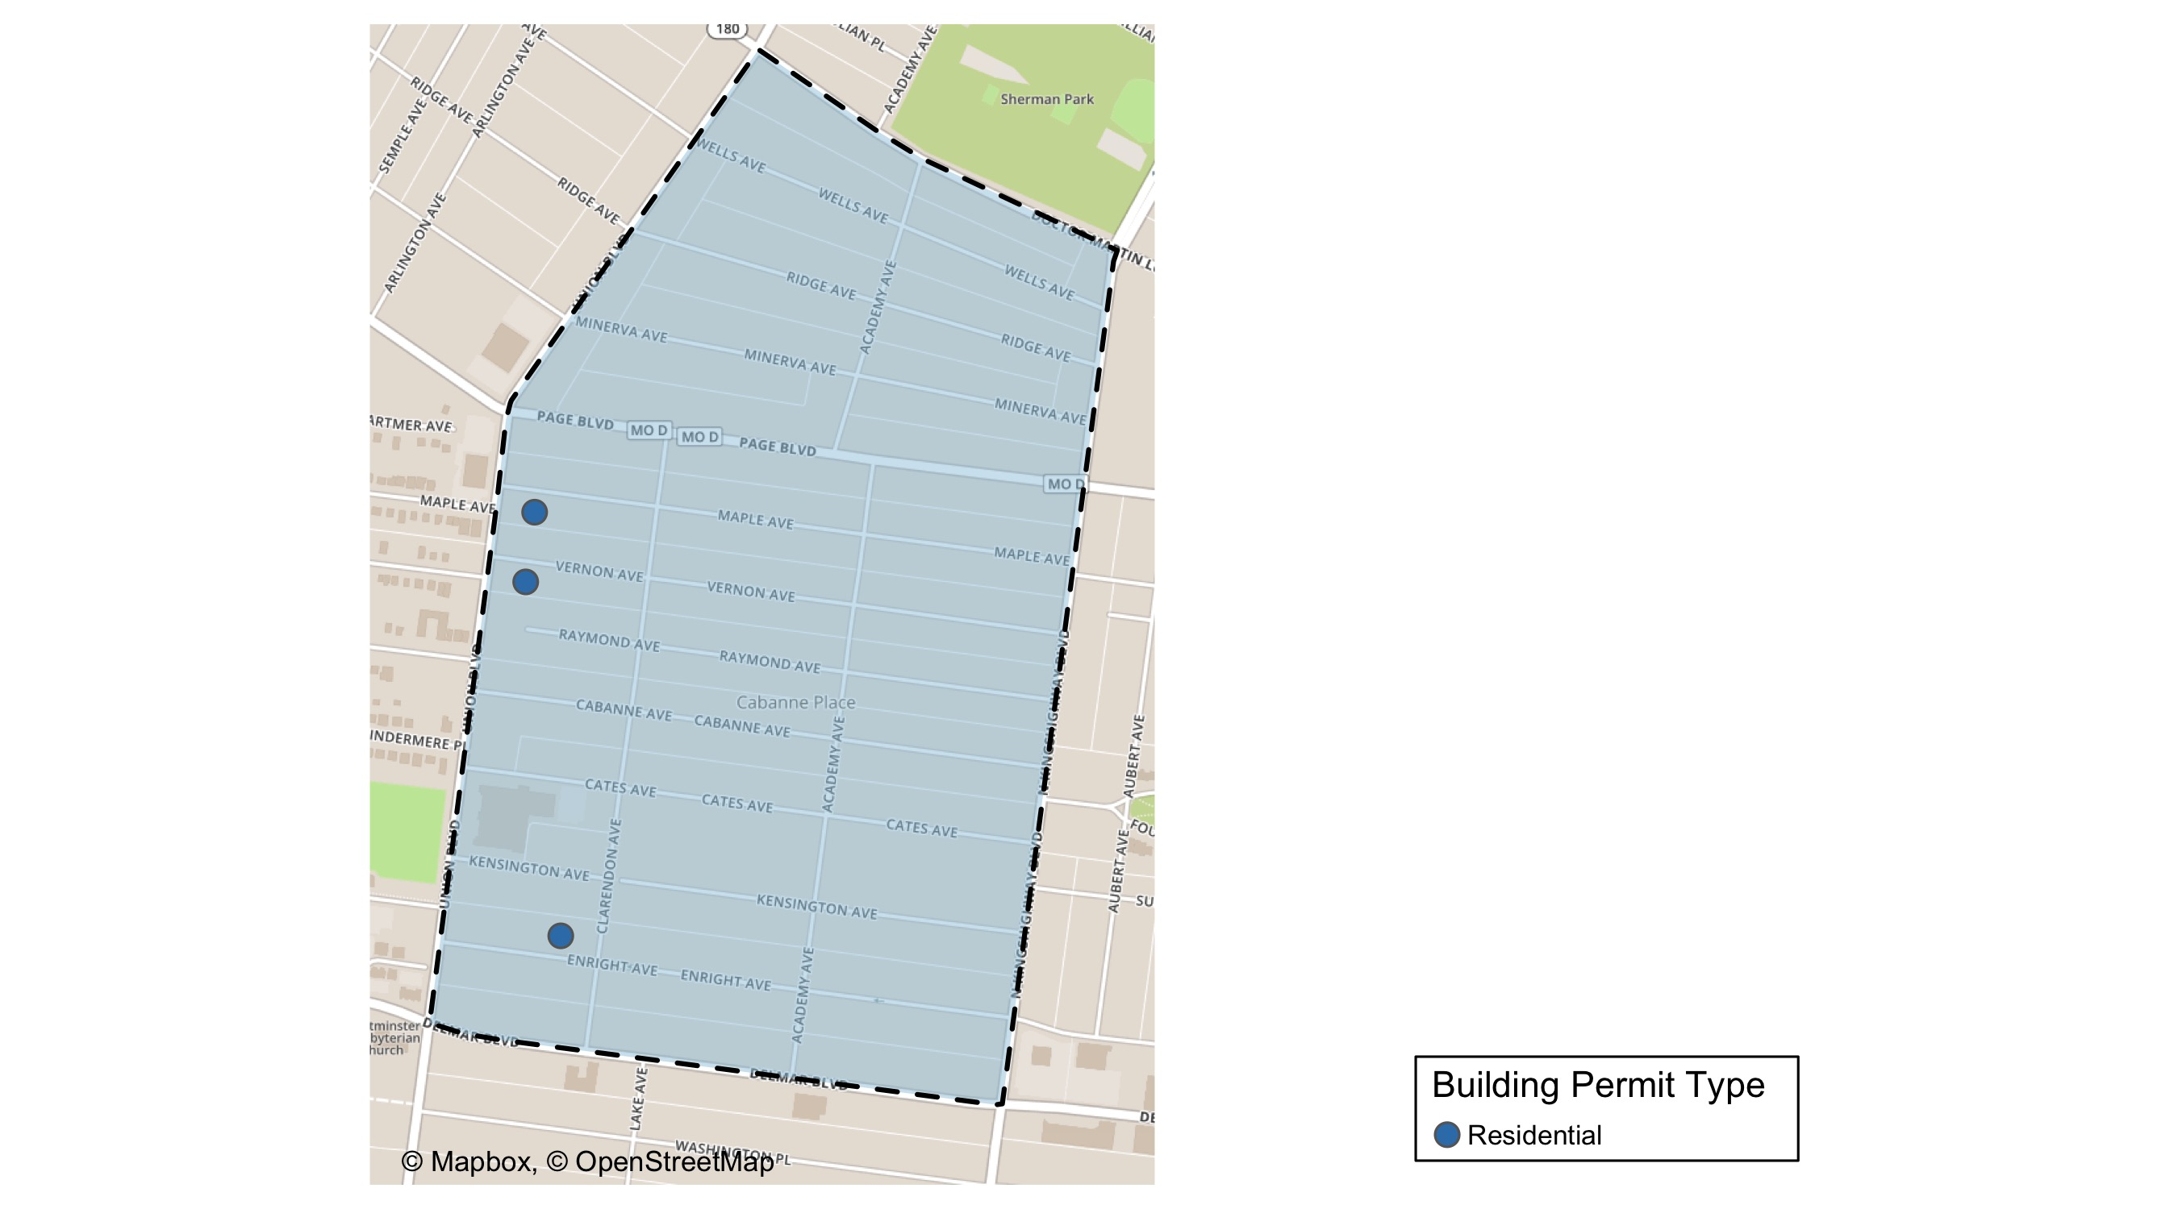
Academy

Slide 37
Neighborhood Summary
April 2021 | April 2021 | April 2021 | April 2021
Permit Use | Average Cost | # of Permits | Total Value of Permits
Commercial | $0 | 0 | $0
Industrial | $0 | 0 | $0
Institutional | $0 | 0 | $0
Residential | $151,125 | 3 | $453,375
Last 6 Months | Last 6 Months | Last 6 Months | Last 6 Months
Permit Use | Average Cost | # of Permits | Total Value of Permits
Commercial | $7,000 | 3 | $21,000
Industrial | $0 | 0 | $0
Institutional | $0 | 0 | $0
Residential | $70,102 | 13 | $911,325

Slide 38
Academy Individual Permit Breakdown
Owner | New Use | Cost | address
5258 MAPLE LLC | Residential | $2,000 | 5258 MAPLE AV
5256 VERNON LLC | Residential | $450,000 | 5256 VERNON AV
SYMS, MELBA DEE JOHNSON | Residential | $1,375 | 5217 ENRIGHT AV

Slide 39
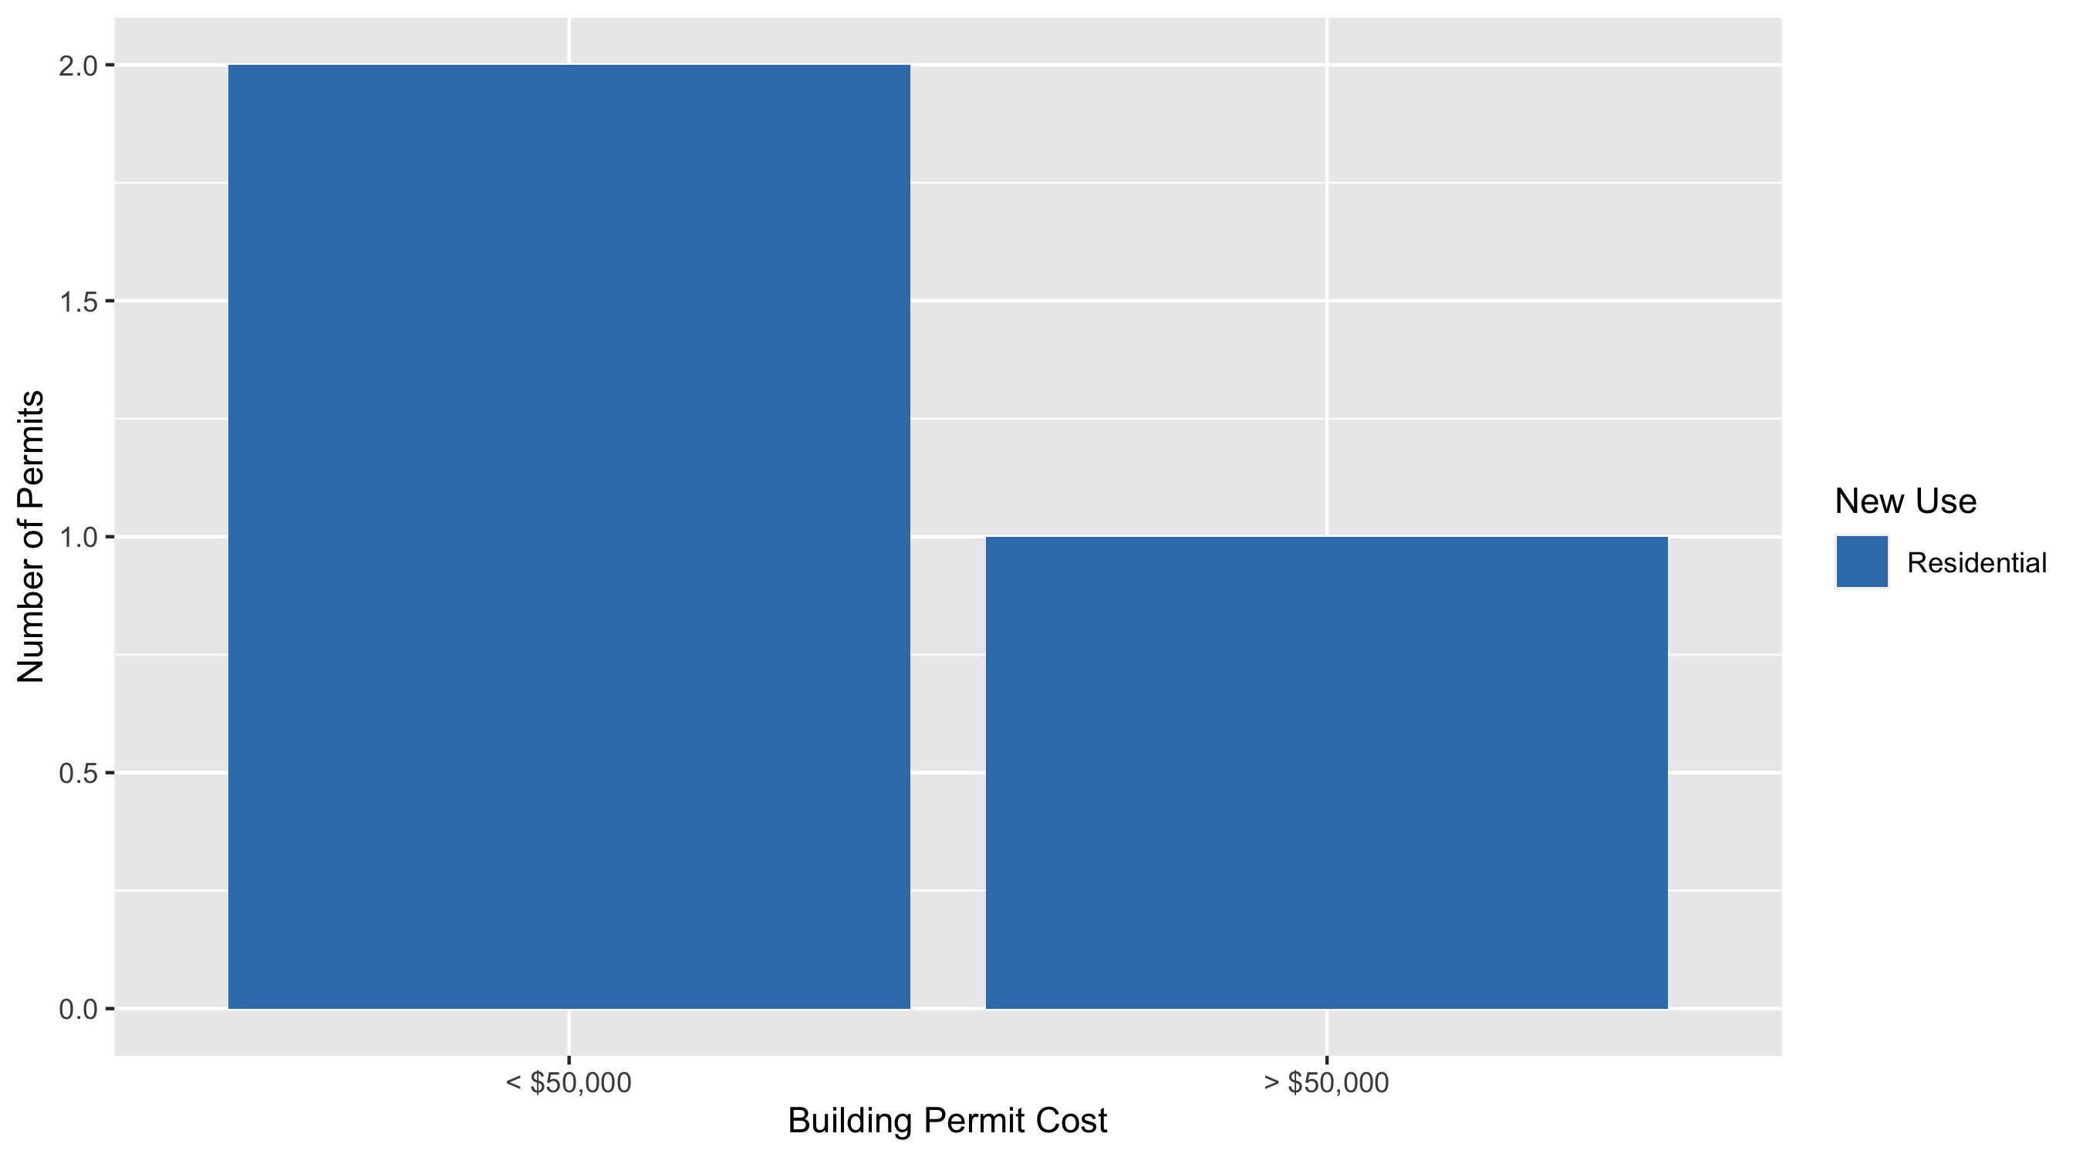
Academy Permit Cost Breakdown

Slide 40
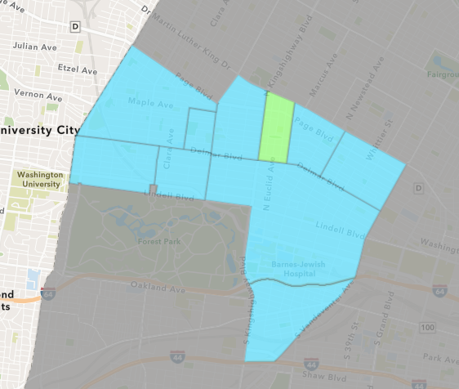
Fountain Park
April 2021 Neighborhood Cost Breakdown
Mean: $15,667
Median: $13,000
Range: $1,000 - $35,669

Slide 41
Fountain Park: Summary Notes
4 building permits in April 2021
100.00% change compared to April 2020 (2 total building permits)
$15,667: Average building permit cost in April 2021
944.48% change compared to April 2020 ($1,500)
9 total building permits in 2021
350.00% change YTD compared to this time in 2020 (2 total building permits)
$323,057: YTD average building permit cost in 2021
21437.16% change YTD compared to this time in 2020 ($1,500)

Slide 42
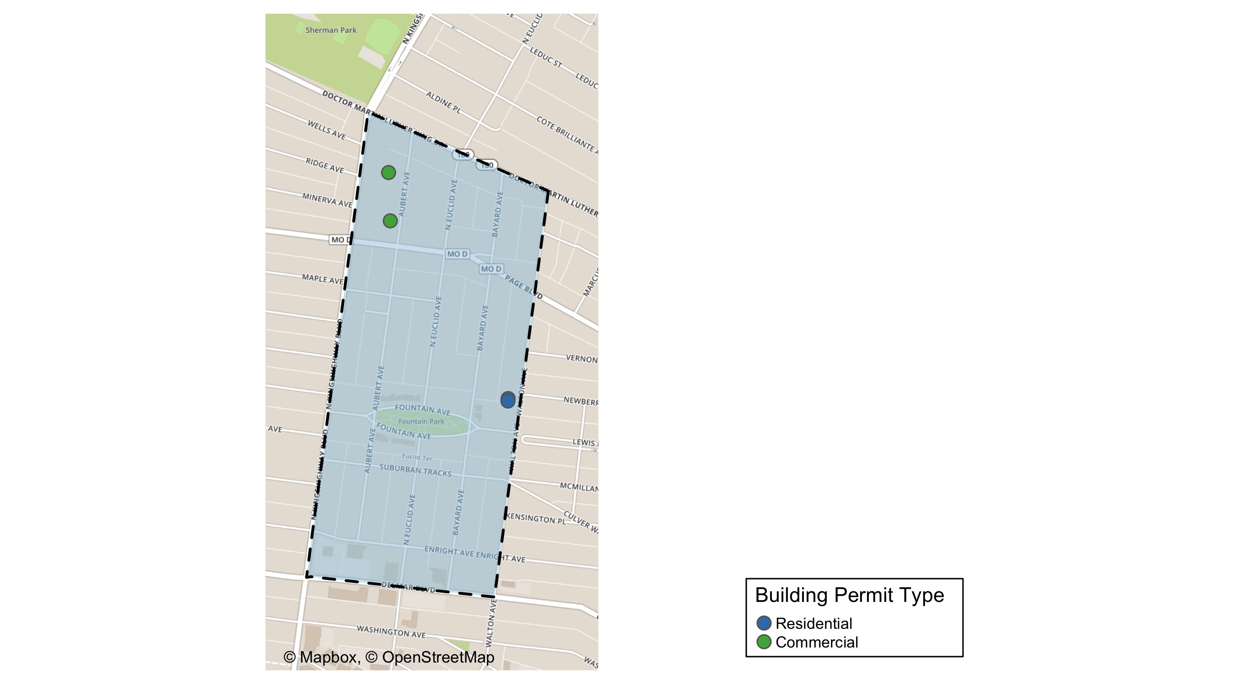
Fountain Park

Slide 43
Neighborhood Summary
April 2021 | April 2021 | April 2021 | April 2021
Permit Use | Average Cost | # of Permits | Total Value of Permits
Commercial | $30,334 | 2 | $60,669
Industrial | $0 | 0 | $0
Institutional | $0 | 0 | $0
Residential | $1,000 | 2 | $2,000
Last 6 Months | Last 6 Months | Last 6 Months | Last 6 Months
Permit Use | Average Cost | # of Permits | Total Value of Permits
Commercial | $585,603 | 5 | $2,928,017
Industrial | $0 | 0 | $0
Institutional | $0 | 0 | $0
Residential | $1,900 | 5 | $9,500

Slide 44
Fountain Park Individual Permit Breakdown
Owner | New Use | Cost | address
URBAN LEAGUE OF METROPOLITAM ST LOUI | Commercial | $25,000 | 1408 N KINGSHIGHWAY BLVD
LRA | Residential | $1,000 | 1125 WALTON AV
LRA | Residential | $1,000 | 1127 WALTON AV
ROBERTS PLAZA LLC | Commercial | $35,669 | 1315 AUBERT AV

Slide 45
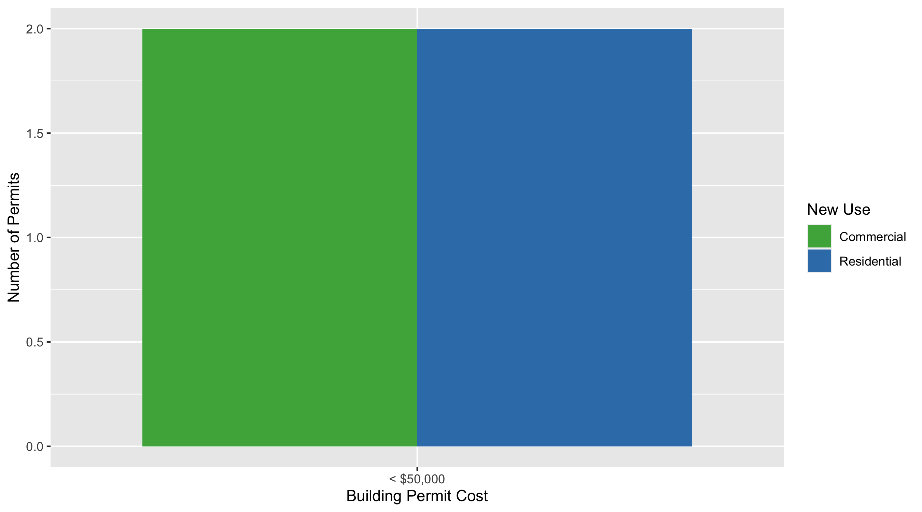
Fountain Park Permit Cost Breakdown

Slide 46
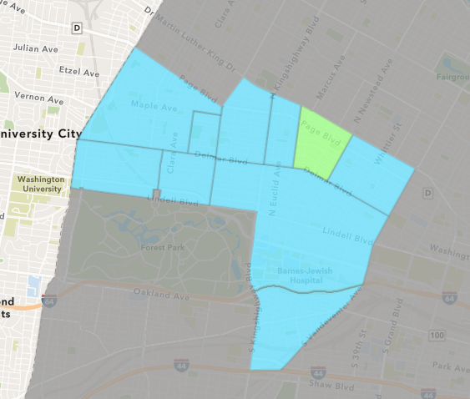
Lewis Place
April 2021 Neighborhood Cost Breakdown
Mean: $2,333
Median: $3,000
Range: $1,000 - $3,000

Slide 47
Lewis Place: Summary Notes
3 building permits in April 2021
Infinite change compared to April 2020 (0 total building permits)
$2,333: Average building permit cost in April 2021
Infinite change compared to April 2020 ($0)
7 total building permits in 2021
600.00% change YTD compared to this time in 2020 (1 total building permits)
$9,560: YTD average building permit cost in 2021
282.42% change YTD compared to this time in 2020 ($2,500)

Slide 48
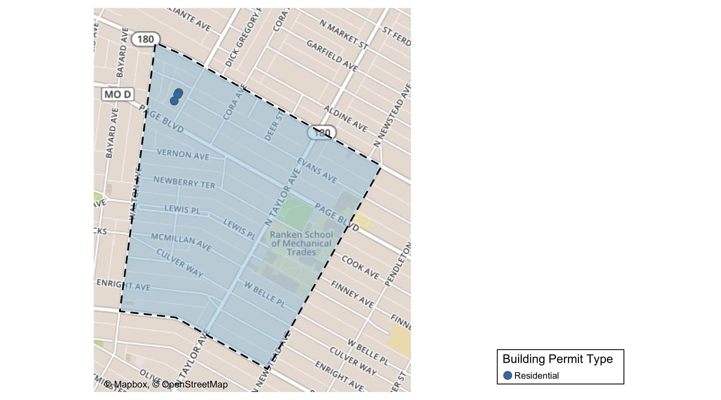
Lewis Place

Slide 49
Neighborhood Summary
April 2021 | April 2021 | April 2021 | April 2021
Permit Use | Average Cost | # of Permits | Total Value of Permits
Commercial | $0 | 0 | $0
Industrial | $0 | 0 | $0
Institutional | $0 | 0 | $0
Residential | $2,333 | 3 | $7,000
Last 6 Months | Last 6 Months | Last 6 Months | Last 6 Months
Permit Use | Average Cost | # of Permits | Total Value of Permits
Commercial | $10,000 | 1 | $10,000
Industrial | $0 | 0 | $0
Institutional | $0 | 0 | $0
Residential | $9,785 | 9 | $88,063

Slide 50
Lewis Place Individual Permit Breakdown
Owner | New Use | Cost | address
EBO PROPERTIES LLC | Residential | $3,000 | 1335 MARCUS AV
EBO PROPERTIES LLC | Residential | $1,000 | 1337 MARCUS AV
EBO PROPERTIES LLC | Residential | $3,000 | 1325 MARCUS AV

Slide 51

Lewis Place Permit Cost Breakdown

Slide 52
Additional Notes
Data retreived from https://www.stlouis-mo.gov/data/
Building permits with a cost of $0 were dropped
Building permits that were cancelled were dropped
Infinite change indicates 0 permits in the current or previous time period/comparison month so there was a overall increase or decrease

